Slide 1
Vehicle Calculator
Artificial Intelligence design

Slide 2
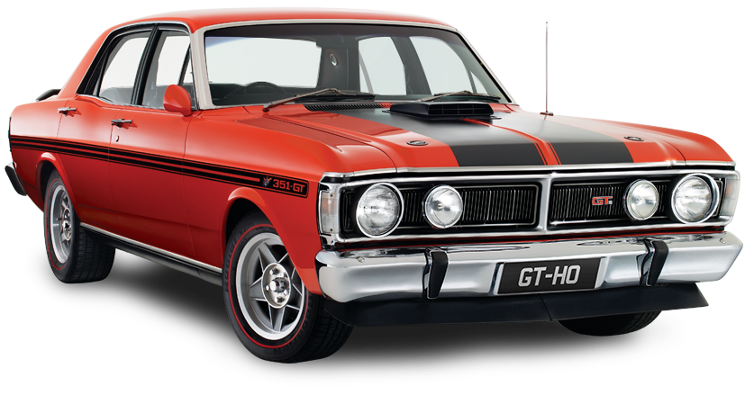
motivation
build an application that had something to do with cars.
Curiosity, vehicle pricing, contributing factors

Slide 3
Related work
https://www.kaggle.com/abineshkumark/carsdata
https://github.com/dkeske/CarPrice
- Linear and ridge regression to predict price of a car based on car adds posted on a website
https://towardsdatascience.com/build-develop-and-deploy-a-machine-learning-model-to-predict-cars-price-using-gradient-boosting-2d4d78fddf09
- 4 regression models based on features. Choosing the model with the best correlation and Root Mean Squared Error

Slide 4
Vehicle industry
How do they come up with their pricing?

Slide 5
Vehicle industry
How do they come up with their pricing?

Slide 6
Vehicle industry
How do they come up with their pricing?
Origin

Slide 7
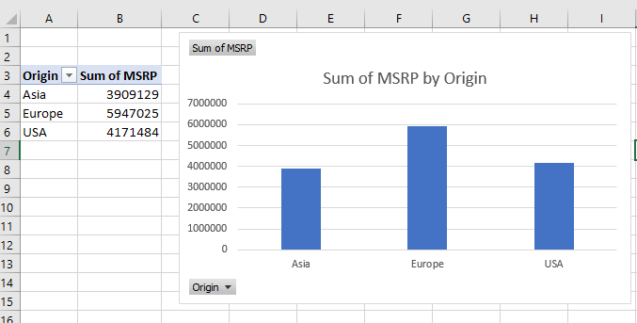
Vehicle industry
How do they come up with their pricing?
Origin:
Europe
Asia
USA

Slide 8
Vehicle industry
How do they come up with their pricing?
Origin
Make

Slide 9
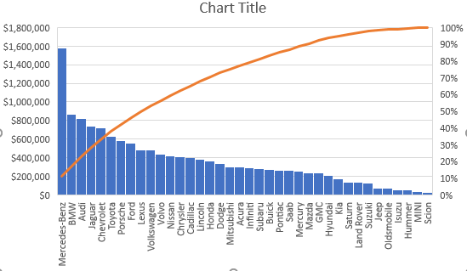
Vehicle industry
How do they come up with their pricing?
Make

Slide 11
Questions?

